Slide 1


2025 Imperial College EEE Project
Predictive maintenance for social housing

Slide 2


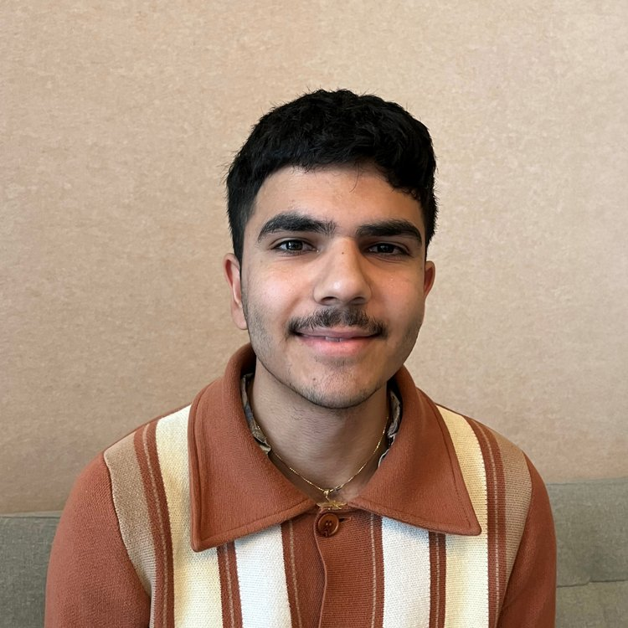
Your Supervisors
Balazs Csuvar Director of Innovation & Net Zero, DG Cities balazs.csuvar@dgcities.com
Imperial College CivEng alumni. Balazs leads the delivery of our innovation projects, solving challenges through the integration of new technologies and holistic thinking. He is a civil engineer by background, with 10 years of international experience as an urban consultant, leading a wide range of projects from developing smart city strategies, planning connected and autonomous mobility, and in local government capacity building.
Nima Karshenas Innovation Consultant, DG Cities nima.karshenas@dgcities.com
EEE Meng alumni, Nima previously collaborated with DG Cities on a digital connectivity initiative in Greenwich and worked for a year in industry with PlayStation. Nima contributes his in-depth technical knowledge of AI, Statistics, and Signal Processing to diverse projects that promote social impact and sustainability. He appreciates the broad scope of projects at DG Cities, offering insights and embracing the opportunity to shape a brighter future for cities and communities.

Slide 3

About us
Established in 2015 by the Royal Borough of Greenwich to advance urban innovation.
We provide bespoke consultancy and independent evaluations for local authorities, as well as private and public sector clients.
Our expertise includes decarbonisation strategies, behavioural science programmes, and neighbourhood-level consultancy.
We help councils invest in energy, housing, and transport, piloting and implementing new technologies, digital solutions, and mobility systems.

Slide 4
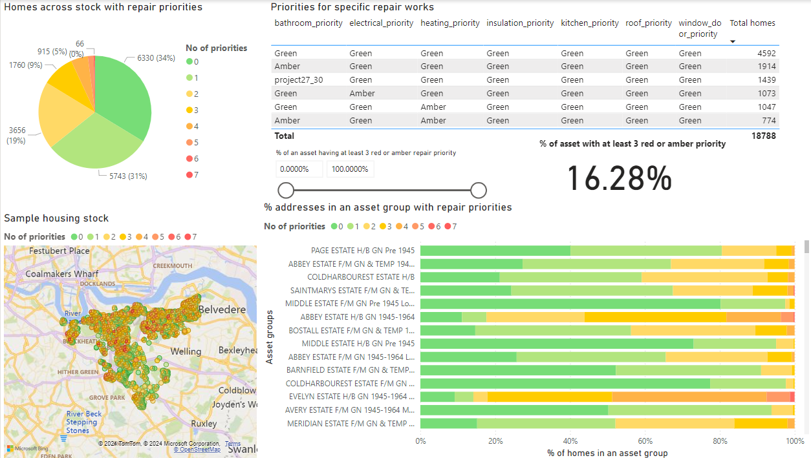
Project Context
DG Cities currently provides software analysing data of council homes, compiling data from a wide range of sources.
Goal is to help asset owners prioritise spending effectively, currently being done by integrating different performance indicators in a co-designed (with the council) prioritisation methodology.
DG Cities identified potential enhancement by integrating predictive analytics into the model as a means of preventative, rather than reactive repairs.

Slide 5
Data Overview
Dataset Size: ~1e6 historical repair records over a portfolio of over 20,000 properties.
Data Span: 4 years. (2021-2025)
Data features:
Historical maintenance records (type of repair, repair cost, date of issue, date of completion, occupation status, minor/major repair)
Property attributes (age, location, building type)

Slide 6
Technical Deliverables
There are 2 key strands of work that you can put more/less focus on.
Machine Learning Model Development
Select appropriate ML algorithms (Random Forest, Gradient Boosting, Neural Networks, Transformers)
Problem formulation (what kind of problem do you want to frame it as (time-series, binary classification etc.), what level of time-wise granularity will provide optimal results? Experiment and explore!
Feature engineering based on property condition, historical repairs, location, and other predictors
Iterative model training and testing
Optimisation, validation & evaluation of predictive accuracy.
Database management & Data pipelines
What kind of database platform suits this task? think costs, security, data privacy, ease-of-use and maintenance.
How will new data be ingested into the database, and how will this update predictions?
What api’s can be setup to access this data remotely?
Can LLMs be leveraged to query data using natural language?

Slide 7
Results & Strategy
For those who want to focus on business value and consultancy. Some questions to think about:
What property types/archetypes are the most problematic?
Can you implement a repairs strategy based on predicted repairs for 2025-2026?
What input features are most predictive of future repairs?
How can the dataset be improved for more predictive power, or more useful outputs?
How should the council integrate the predictive tool into their repairs workflow? What are the main barriers to adoption and how can they be mitigated?

